Slide 1
CAPSTONE PROJECTDAGOHOY’S REVOLT: A 3D EDUCATIONAL GAME ABOUT DAGOHOY

Slide 2
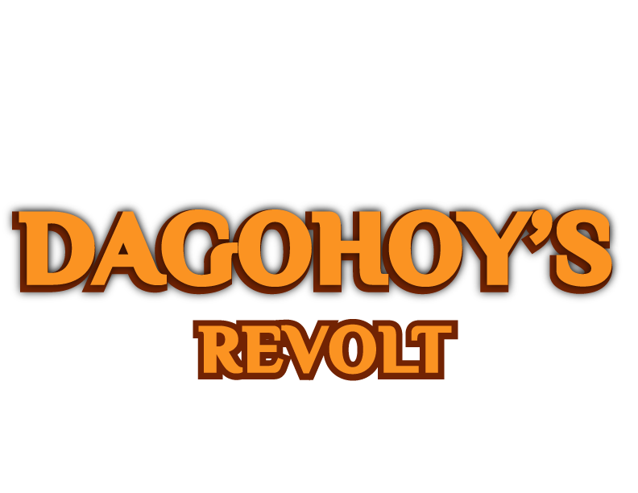
3D

Slide 3
Chapter I Introduction

Slide 4
Project Context
There are a lot of National hero in the Philippines just like Jose Rizal, Lapu-Lapu and many more. But some of them doesn’t get the recognition they deserve. And one of them is Francisco Sendrijas or also known as “Dagohoy”.
People knew the name Dagohoy, but they don’t really recognize who he really is. What’s worst is even his fellow Boholanos doesn’t really know him well. We the researchers think that Dagohoy should be recognized not only on the Province of Bohol, but also in the whole country, Philippines.

Slide 5
Statement of the Problem
People knew the name Dagohoy, but they don’t really recognize who he really is. What’s worst is even his fellow Boholanos doesn’t really know him well.
This research project aims to educate people about Francisco Dagohoy by creating a 3D Educational Game. And here are the following problems we look up:
What is the purpose of this 3D Educational Game?
What do you want to accomplished in your 3D Educational Game?
How will you able to educate the people?
What is the difference in traditional way of learning to non-traditional way?
Can the game be played without an internet connection?
How to install the game? ­­

Slide 6
Purpose
The purpose of this project is to educate people about Bohol’s history. Specifically, one of Bohol’s mighty hero Francisco Dagohoy.
Today’s games does not only capture children attention but also the teens and adults. This is perfect for our project’s target users which are children and youth.

Slide 7
Objectives
The main objective of this project is to create a game that is both educational and also entertaining.
To create game that will have a campaign/story mode that tells the story of Francisco Dagohoy’s revolt.
To create a game playable for PC and Mobile device and it can be played online and offline.
To create a website which contains the download page and trailer of the game.

Slide 8
Significance of the Study This project will benefit the following:
Children and Youth
This project will enlighten them about one of major events of the history in Bohol.
Future Researchers
This project will help the build their ground on how to start and develop an Educational game.

Slide 9
Scope and Limitations
This game is a 3D Adventure RPG (Role Playing Game). The game has a Campaign/Story Mode that narrates the events on Francisco Dagohoy’s revolt.

Slide 10

Review of Related Literature
According to the article of Teemu H. Laine (2018) entitled “Mobile Educational Augmented Reality Games: A Systematic Literature Review and Two Case Studies”, she define mobile AR as a type of AR where a mobile device (smartphone or tablet) is used to display and interact with virtual content, such as three-dimensional (3D) models, annotations, and videos, that are overlaid on top of a real-time camera feed of the real world.

Slide 11
Educational games are not today. Since the introduction of video games on 1970’s a lot of games are released that are considered as an educational game.
Historical Background

Slide 12
There are a lot of ways to develop a game. Especially today there are a lot of game engines that are free to use like Godot, Unreal, Unity and etc. We choose to use Unity because there are many tools and packages that can help us in our development.
CHAPTER III
Technical Background

Slide 13






Review of Related Literature
Visual Studio Code
Unity
Blender
C#
Adobe Photoshop
Adobe Illustrator

Slide 14


Slide 15
Thank You!

